Slide 1
Module: Virtual Layer
Upon completion of this module, you should be able to:
Describe the virtual layer and virtualization software
Describe a resource pool and virtual resources
Notes:
This module focuses on the entities of the virtual layer of the cloud computing reference model. This module focuses on virtualization software, resource pool, and virtual resources.

Slide 2
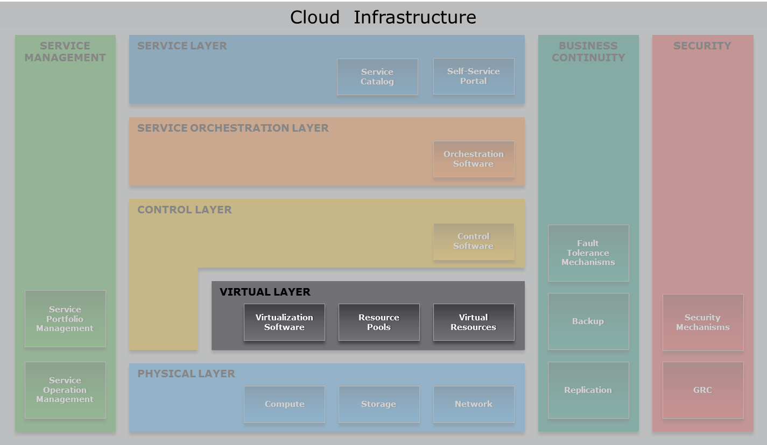
Cloud Computing Reference Model
Virtual Layer
Notes:
Virtual layer is deployed on the physical layer. It specifies the entities that operate at this layer, such as virtualization software, resource pools, and virtual resources. The key function of this layer is to abstract physical resources, such as compute, storage, and network, and making them appear as virtual resources. Other key functions of this layer include executing the requests generated by control and forwarding requests to the physical layer to get them executed. Examples of requests generated by control layers include creating pools of resources and creating virtual resources.

Slide 3
Lesson: Virtual Layer Overview
This lesson covers the following topics:
Virtual layer
Virtualization software
Resource pool
Virtual resources
Notes:
This lesson covers an overview of virtual layer, virtualization software, resource pool, and virtual resources.

Slide 4
Introduction to Virtualization
Virtualization
Refers to the logical abstraction of physical resources, such as compute, network, and storage that enables a single hardware resource to support multiple concurrent instances of systems or multiple hardware resources to support single instance of system.
Enables a resource to appear larger or smaller than it actually is
Enables a multitenant environment improving utilization of physical resources
Notes:
Virtualization refers to the logical abstraction of physical resources, such as compute, network, and storage that enables a single hardware resource to support multiple concurrent instances of systems or multiple hardware resources to support single instance of system. For example, a single disk drive can be partitioned and presented as multiple disk drives to a compute system. Similarly, multiple disk drives can be concatenated and presented as a single disk drive to a compute system.
With virtualization, it is also possible to make a resource appear larger or smaller than it actually is. Further, the abstraction of physical resources due to virtualization enables multitenant environment, which improves utilization of the physical resources.

Slide 5
Benefits of Virtualization
Optimizes utilization of IT resources
Reduces cost and management complexity
Reduces deployment time
Increases flexibility
Notes:
Virtualization when deployed offers several benefits to build a cloud infrastructure. It enables consolidation of IT resources that helps service providers to optimize their utilization of infrastructure resource. Improving the utilization of IT assets can help service providers to reduce the costs associated with the purchasing of a new hardware. It also reduces space and energy costs associated with maintaining the resources. Moreover, less people are required to administer these resources, which further lower the cost. Virtual resources are created using software that enables service providers to deploy infrastructure faster as compared to deploying physical resources. Virtualization increases flexibility by allowing to create and reclaim the logical resources that are based on business requirements.

Slide 6
Virtual Layer Overview
Virtualized compute, network, and storage forms the virtual layer
Enables fulfilling two characteristics of cloud infrastructure
Resource pooling
Rapid elasticity
Specifies the entities operating at this layer
Virtualization software
Resource pools
Virtual resources
Notes:
While building cloud infrastructure, virtual layer is deployed on physical layer. This layer enables fulfilling two key characteristics of cloud infrastructure: resource pooling and rapid elasticity.
Virtual layer specifies the entities that operate at this layer, such as virtualization software, resource pools, and virtual resources. Virtual layer is built by deploying virtualization software on compute systems, network devices, and storage devices.

Slide 7
Virtual Layer
Virtualization Process and Operations
Step 1: Deploy virtualization software on:
Compute systems
Network devices
Storage devices
Step 2: Create resource pools:
Processing power and memory
Network bandwidth
Storage
Step 3: Create virtual resources:
Virtual machines
Virtual networks
LUNs
Virtual resources are packaged and offered as services
Notes:
There are three key steps involved in making resources available to consumers. They are:
Deploying virtualization software
Creating resource pools
Creating virtual resources
The virtualization software preforms the abstraction of the physical resources and are deployed on compute systems, network devices, and storage devices. The key functions of a virtualization software is to create resource pools and create virtual resources.
A resource pool is an aggregation of computing resources, such as processing power, memory, storage, and network bandwidth, which provides an aggregated view of these resources to the control layer. Virtualization software in collaboration with the control software pools the resources. For example, storage virtualization software pools capacity of multiple storage devices to appear as a single large storage capacity. Similarly, by using compute virtualization software, the processing power and memory capacity of the pooled physical compute system can be viewed as an aggregation of the power of all processors (in megahertz) and all memory (in megabyte). Resource pool is discussed in the next lesson.
Virtualization software in collaboration with control layer creates virtual resources. These virtual resources are created by allocating physical resources from the resource pool. These virtual resources share pooled physical resources. Examples of virtual resources include virtual machines, LUNs, and virtual networks. Virtual resources are discussed later in the module.

Slide 8
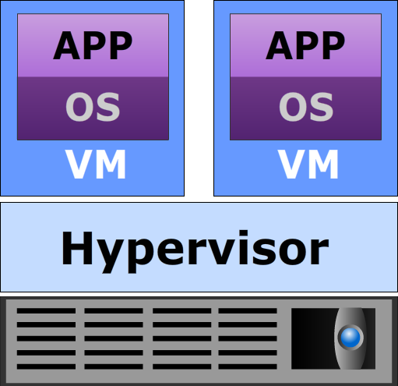

Compute Virtualization Software
Hypervisor
Hypervisor
Software that is installed on a compute system and enables multiple OSs to run concurrently on a physical compute system.
Hypervisor kernel
Provides functionality similar to an OS kernel
Designed to run multiple VMs concurrently
Virtual machine manager (VMM)
Abstracts hardware
Each VM is assigned a VMM
Each VMM gets a share of physical resources
VMM
VMM
Hypervisor Kernel
Notes:
The software used for compute virtualization is known as the hypervisor. The hypervisor is a software that is installed on a compute system and enables multiple operating systems to run concurrently on a physical compute system. The hypervisor along with hypervisor management software (also known as control software, which is discussed in ‘Control Layer’ module) is the fundamental component for deploying software defined compute environment. The hypervisor abstracts the physical compute hardware to create multiple virtual machine, which to the operating systems look and behave like physical compute systems. The hypervisor provides standardized hardware resources, such as processor, memory, network, and disk to all the virtual machines.
A hypervisor has two key components: kernel and virtual machine manager (VMM). A hypervisor kernel provides the same functionality like the kernel of any other operating system, including process creation, file system management, and process scheduling. It is designed and optimized to run multiple virtual machines concurrently. A VMM abstracts hardware and appears as a physical compute system with processor, memory, I/O devices, and other components that are essential for operating systems and applications to run. Each virtual machine is assigned a VMM that gets a share of the processor, memory, I/O devices, and storage from the physical compute system to successfully run the virtual machine.

Slide 9
Compute Virtualization Software (Cont'd)
Types of Hypervisor
Bare-metal Hypervisor
It is an operating system
Installed on a bare-metal hardware
Requires certified hardware
Suitable for enterprise data centers and cloud infrastructure
Hosted Hypervisor
Installed as an application on an OS
Relies on OS, running on physical machine for device support
Suitable for development, testing, and training purposes
Notes:
Hypervisors can be categorized into two types: bare-metal hypervisor and hosted hypervisor. A bare-metal hypervisor is directly installed on the hardware. It has direct access to the hardware resources of the compute system. Therefore, it is more efficient than a hosted hypervisor. However, this type of hypervisor may have limited device drivers built-in. Therefore, hardware certified by the hypervisor vendor is usually required to run bare-metal hypervisors. A bare-metal hypervisor is designed for enterprise data centers and cloud infrastructure. It also supports advanced capabilities such as resource management, high availability, security, and so on. In contrast to a bare-metal hypervisor, a hosted hypervisor is installed as an application on an operating system. In this approach, the hypervisor does not have direct access to the hardware and all requests must pass through the operating system running on the physical compute system. Hosted hypervisors are compatible with all the devices that are supported by the operating system on which it is installed. Using this type of hypervisor adds overhead compared to a bare-metal hypervisor, because there are many services and processes running on an operating system that are consuming compute system resources. Therefore, a hosted hypervisor is most suitable for development, testing, and training purposes.

Slide 10
Network Virtualization Software
Abstracts physical network resources to create virtual resources:
Virtual LAN/virtual SAN
Virtual Switch
Network virtualization software can be:
Built into the operating environment of a network device
Installed on an independent compute system
Fundamental component for deploying software defined network
Hypervisor’s capability
Notes:
The network virtualization software is either built into the operating environment of a network device, installed on an independent compute system (discussed in ‘Control Layer’ module) or available as hypervisor’s capability. The network virtualization software abstracts physical network resources to create virtual resources such as virtual LANs or virtual SANs.
The network virtualization software built into the network device operating environment has the ability to abstract the physical network. It has the ability to divide a physical network into multiple virtual networks, such as virtual LANs and virtual SANs.
The network virtualization software installed on an independent compute system is the fundamental component for deploying software defined network environment. This software provides a single control point to the entire network infrastructure enabling automated and policy based network management.
The network virtualization can also be available as hypervisor’s capability, which emulates network connectivity among VMs on a physical compute system. This software enables creating virtual switches that appears to the VM as physical switches.

Slide 11
Storage Virtualization Software
Abstracts physical storage resources to create virtual resources:
Virtual volumes
Virtual disk files
Virtual arrays
Storage virtualization software can be:
Built into the operating environment of a storage device
Installed on an independent compute system
Fundamental component for deploying software defined storage
Hypervisor’s capability
Notes:
The storage virtualization software is either built into the operating environment of a storage device, installed on an independent compute system (discussed in ‘Control Layer’ module), or available as hypervisor’s capability. The storage virtualization software abstracts physical storage resources to create virtual resources, such as virtual volumes or virtual arrays.
The storage virtualization software built into the array operating environment has the ability to pool and abstract the physical storage devices and present it as a logical storage.
The storage virtualization software installed on an independent compute system is the fundamental component for deploying software defined storage environment. The software has the ability to pool and abstract the existing physical storage devices and present it as an open storage platform. With the help of control software (discussed in ‘Control Layer’ module), the storage virtualization software can perform tasks such as virtual volume creation apart from creating virtual arrays. This software provide a single control point to the entire storage infrastructure, enabling automated and policy based management.
The storage virtualization can also be available as hypervisor’s capability, which enables creating virtual disk that appears to the operating systems as physical disk drives.

Slide 12
Lesson Summary
During this lesson the following topics were covered:
Virtual layer
Virtualization software
Resource pool
Virtual resources
Notes:
This lesson covered an overview of virtual layer, virtualization software (compute, network, storage), resource pool, and virtual resources.

Slide 13
Lesson: Resource Pool
This lesson covers the following topics:
Resource pool
Examples of resource pooling
Identity pool
Notes:
This lesson covers resource pool, examples of resource pooling, and identity pool.

Slide 14
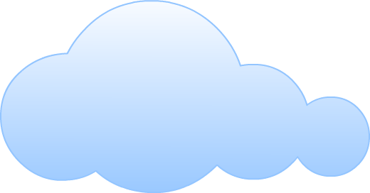

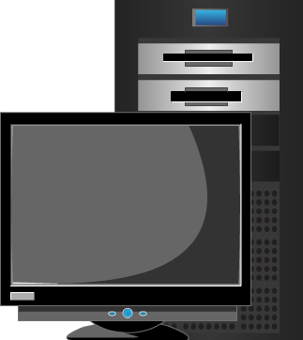
Introduction to Resource Pool
Resource Pool
A logical abstraction of the aggregated computing resources, such as processing power, memory capacity, storage, and network bandwidth that are managed collectively.
Cloud services obtain computing resources from resource pools
Resources are dynamically allocated as per consumer demand
Resource pools are sized according to service requirements
Resources for Aggregation
Service A
Consumer A
Resource Allocation
Consumer B
Resource Pool
Service B
Cloud Infrastructure
Notes:
A resource pool is a logical abstraction of the aggregated computing resources, such as processing power, memory capacity, storage, and network bandwidth that is managed collectively. Cloud services obtain computing resources from resource pools. Resources from the resource pools are dynamically allocated according to consumer demand, up to a limit defined for each cloud service. The allocated resources are returned to the pool when they are released by consumers, making them available for reallocation. The figure on the slide shows the allocation of resources from a resource pool to service A and service B that are assigned to consumer A and consumer B respectively.
Resource pools are designed and sized according to the service requirements. A cloud administrator can create, remove, expand, or contract a resource pool as needed. In a cloud infrastructure, multiple pools of same or different resource types may be configured to provide various cloud services. For example, two independent storage pools in a cloud having different performance characteristics can provide resources to a high-end and a mid-range storage service. Another example is an application service, which can obtain processing power from a processor pool and network bandwidth from a network bandwidth pool.

Slide 15

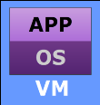
Example: Pooling Processing Power and Memory Capacity
Assigned to
Consumer A
Resource Allocation
Processing power = 1500 MHz
Memory Capacity = 2 GB
Compute System 1
Processing Power = 4000 MHz
Memory Capacity = 6 GB
Resource Allocation
Processing power = 1500 MHz
Memory Capacity = 2 GB
Service A
Service B
Compute System 2
Processing Power = 4000 MHz
Memory Capacity = 6 GB
Resource Allocation
Processing power = 1500 MHz
Memory Capacity = 2 GB
Resource Allocation
Processing power = 1500 MHz
Memory Capacity = 2 GB
Compute System 3
Processing Power = 4000 MHz
Memory Capacity = 6 GB
Resource Allocation
Processing power = 1500 MHz
Memory Capacity = 2 GB
Processor Pool: Processing Power = 12000 MHz
Memory Pool: Memory Capacity = 18 GB
Assigned to
Consumer B
Notes:
Cloud services comprising virtual machines (VMs) consume processing power and memory capacity respectively from the processor and memory pools from which they are created. The figure on the slide illustrates an example of pooling processing power and memory capacity, and allocating resources to VMs that are elements of service A and service B. These cloud services are assigned to consumer A and consumer B.
The figure on the slide shows a processor pool aggregates the processing power of three physical compute systems running hypervisor. Likewise, a memory pool aggregates the memory capacity of these compute systems. Therefore, the processor pool has 12000 MHz of processing power and the memory pool possesses 18 GB of memory capacity. Each VM is allocated 1500 MHz of processing power and 2 GB of memory capacity at the time they are created. After allocation of resources to the VMs, the processor pool has 4500 MHz processing power and the memory pool has 8 GB memory capacity remaining, which can be allocated to new or existing VMs according to service demand.

Slide 16
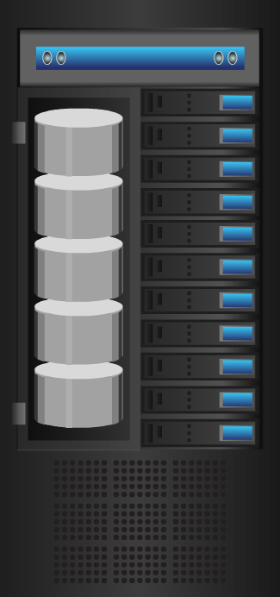


Example: Pooling Storage in a Block-based Storage System
Block-based Storage System
Service A
Resource Allocation
Assigned to
Consumer A
Drive 1
Storage Space =
1000 GB
LUN
Storage Space = 200 GB
Service B
Drive 2
Storage Space =
1000 GB
Resource Allocation
Assigned to
Consumer B
LUN
Storage Space = 400 GB
Drive 3
Storage Space = 1000 GB
Service C
Resource Allocation
Assigned to
Consumer C
Drive 4
Storage Space =
1000 GB
LUN
Storage Space = 800 GB
Storage Pool: Storage Space = 4000 GB
Notes:
A storage pool in a block-based storage system comprises the aggregated physical storage space of a set of physical drives. Storage space is allocated from the storage pool to logical unit number (LUN) that are created from the pool. These LUNs are provisioned to consumers upon receiving their storage requests. The figure on the slide illustrates an example where storage space of a set of physical drives are pooled and required storage space is allocated to LUNs from the pool.
The figure on the slide shows a storage pool in a block-based storage system aggregates the storage space of four physical drives. Combining the usable storage space of these drives, the storage pool has 4000 GB of storage space. Three LUNs are provisioned from this pool, which are elements of service A, service B, and service C. These services are assigned to three consumers – consumer A, consumer B, and consumer C. These LUNs are allocated 200 GB, 400 GB, and 800 GB of storage space as per the storage requirement of the consumers. After allocation of storage resources to the LUNs, the storage pool has 2600 GB storage space remaining, which can be allocated to new or existing LUNs according to service demand.

Slide 17
Example: Pooling Storage Across Block-based Storage Systems
Assigned to
Consumer A
Assigned to
Consumer B
Assigned to
Consumer C
Service A
Service B
Service C
LUN
LUN
LUN
Block-based
Storage System
Block-based
Storage System
Block-based
Storage System
Block-based
Storage System
Storage
Pool
Storage
Pool
Higher-level Storage Pool
Notes:
The figure on the slide illustrates an example of a more complex storage pooling, where a higher-level storage pool is created by aggregating the storage space of four storage pools configured within four block-based storage systems. Storage space from the higher-level storage pool is allocated to LUNs that are elements of service A, service B, and service C. These services are assigned to consumer A, consumer B, and consumer C.
Pooling across multiple storage systems provides a unified platform for provisioning storage services that can store data at a massive scale Multiple pools can be created in a cloud environment having different performance and availability levels. They cater to the needs of various storage service offerings.

Slide 18
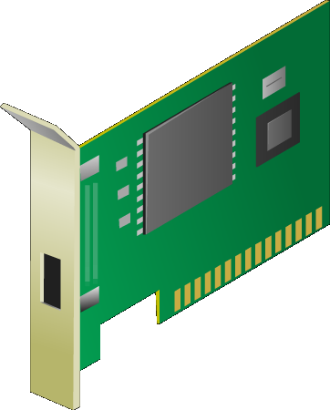
Example: Pooling Network Bandwidth of NICs
Service A
Service B
Assigned to
Consumer A
Assigned to
Consumer B
Resource Allocation
Bandwidth = 600 Mbps
Bandwidth = 300 Mbps
Compute System
NIC 1
Bandwidth =
1000 Mbps
NIC 2
Bandwidth =
1000 Mbps
NIC 3
Bandwidth =
1000 Mbps
Network Bandwidth Pool: Bandwidth = 3000 Mbps
Notes:
Cloud services comprising VMs obtain network bandwidth from network bandwidth pools. VMs are allocated appropriate network bandwidth to meet the required service level. The figure on the slide illustrates an example where a network bandwidth pool is created by aggregating the network bandwidth of three physical network interface cards (NICs). These NICs are installed on a physical compute system running a hypervisor.
The figure on the slide shows the network bandwidth pool has 3000 Mbps of network bandwidth. Service A and service B are allocated 600 Mbps and 300 Mbps network bandwidth respectively as per the data transfer requirement of the consumers. Service A and Service B are assigned to Consumer A and Consumer B respectively. After allocation of bandwidth to the services, the network bandwidth pool has 2100 Mbps of network bandwidth remaining, which can be allocated to new or existing services as needed.

Slide 19
Identity Pool
Specifies a range of network identifiers (IDs) such as virtual network IDs and MAC addresses
IDs are allocated from the identity pools to the elements of cloud services
An identity pool may map to a particular service or to a group of services
Service A
ID Allocation
Assigned to
Consumer A
ID Range: 1 to 10
Identity Pool A
Service B
ID Allocation
Assigned to
Consumer B
ID Range: 11 to 100
Identity Pool B
Notes:
An identity pool, unlike a resource pool, specifies a range of network identifiers (IDs), such as virtual network IDs and MAC addresses. These IDs are allocated from the identity pools to the elements of cloud services. For example, in a service, the constituent virtual networks obtain IDs from a virtual network ID pool. Likewise, VMs in a service get MAC addresses from a MAC address pool.
An identity pool may map or allocate IDs to a particular service or to a group of services. For example, service A is mapped to pool A containing IDs 1 to 10 and service B is mapped to pool B containing IDs 11 to 100. If an identity pool is run out of IDs, then administrators may create an additional pool or add more IDs to the existing pool. The 1-to-1 mapping between an identity pool and a service simplifies the tracking of the use of IDs by a particular service. However, this increases management complexity as many identity pools must be created and managed depending on the number of services.

Slide 20
Lesson Summary
During this lesson the following topics were covered:
Resource pool
Examples of resource pooling
Identity pool
Notes:
This lesson covered resource pool and examples of resource pooling, such as pooling processing power, memory capacity, storage, and network bandwidth. It also covered identity pool.

Slide 21
Lesson: Virtual Resources – I
This lesson covers the following topics:
Virtual machine (VM) and VM hardware
VM files and file system to manage VM files
VM console
VM template
Virtual appliance
VM network and its components
Notes:
This lesson covers virtual machine (VM), VM hardware, VM files, and file system to manage VM files. It also covers VM console, VM template, and virtual appliance. Finally, this lesson covers VM network and its components.

Slide 22
Virtual Machine (VM)
Virtual Machine
A logical compute system that, like a physical compute system, runs an OS and applications.
Created by a hypervisor installed on a physical compute system
Comprises virtual hardware, such as virtual processor, memory, storage, and network resources
Appears as a physical compute system to the guest OS
Hypervisor maps the virtual hardware to the physical hardware
Provider provisions VMs to consumers for deploying applications
VMs on the same compute system or cluster run in isolation
Notes:
A virtual machine (VM) is a logical compute system that, like a physical compute system, runs an operating system (OS) and applications. A VM is created by a hosted or a bare-metal hypervisor installed on a physical compute system. A VM has a self-contained operating environment, comprising OS, applications, and virtual hardware, such as a virtual processor, memory, storage, and network resources. An OS, called—a ‘guest’ OS—is installed on a VM in the same way like it is installed on a physical compute system. From the perspective of the guest OS, the VM appears as a physical compute system. As discussed in lesson 1, a virtual machine monitor (VMM) is responsible for the execution of a VM. Each VM has a dedicated VMM. Each VM has its own configuration for hardware, software, network, security, and so on. The VM behaves like a physical compute system, but does not have direct access either to the underlying host OS (when a hosted hypervisor is used) or to the hardware of the physical compute system on which it is created. The hypervisor translates the VM’s resource requests and maps the virtual hardware of the VM to the hardware of the physical compute system. For example, a VM’s I/O requests to a virtual disk drive are translated by the hypervisor and mapped to a file on the physical compute system’s disk drive.
Compute virtualization software enables creating and managing several VMs—each with a different OS of its own—on a physical compute system or on a compute cluster. In a cloud environment, a provider typically provisions VMs to consumers to deploy their applications. The VM hardware and software are configured to meet the application’s requirements. The VMs of consumers are isolated from each other so that the applications and the services running on one VM do not interfere with those running on other VMs. The isolation also provides fault tolerance so that if one VM crashes, the other VMs remain unaffected.

Slide 23
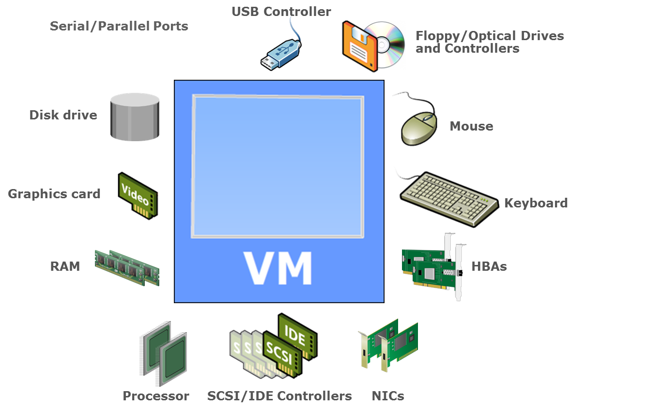
VM Hardware
Notes:
When a VM is created, it is presented with virtual hardware components that appear as physical hardware components to the guest OS. Within a given vendor’s environment, each VM has standardized hardware components that make them portable across physical compute systems. Based on the requirements, the virtual components can be added or removed from a VM. However, not all components are available for addition and configuration. Some hardware devices are part of the virtual motherboard and cannot be modified or removed. For example, the video card and the PCI controllers are available by default and cannot be removed. The figure on the slide shows the typical hardware components of a VM include virtual processor(s), virtual motherboard, virtual RAM, virtual disk, virtual network adapter, optical drives, serial and parallel ports, peripheral devices, and so on.
A VM can be configured with one or more virtual processors. The number of virtual processors in a VM can be increased or reduced based on the requirements. When a VM starts, its virtual processors are scheduled by the hypervisor kernel to run on the physical processors. Each VM is assigned a virtual motherboard with the standardized devices essential for a compute system to function. Virtual RAM is the amount of physical memory allocated to a VM and it can be configured based on the requirements. The virtual disk is a large physical file, or a set of files that stores the VM’s OS, program files, application data, and other data associated with the VM. A virtual network adapter functions like a physical network adapter. It provides connectivity between VMs running on the same or different compute systems, and between a VM and physical compute systems. Virtual optical drives and floppy drives can be configured to connect to either physical devices or to image files, such as ISO and floppy images (.flp), on the storage. SCSI/IDE virtual controllers provide a way for the VMs to connect to the storage devices. The virtual USB controller is used to connect to a physical USB controller and to access connected USB devices. Serial and parallel ports provide an interface for connecting peripherals to the VM.

Slide 24
VM Files
From a hypervisor’s perspective, a VM is a discrete set of files such as:
Configuration file
Stores information, such as VM name, BIOS information, guest OS type, memory size
Virtual disk file
Stores the contents of the VM's disk drive
Memory state file
Stores the memory contents of a VM in a suspended state
Snapshot file
Log file
Stores the VM settings and virtual disk of a VM
Keeps a log of the VM’s activity and is used in troubleshooting
Notes:
From a hypervisor’s perspective, a VM is a discrete set of files on a storage device. Some of the key files that make up a VM are the configuration file, the virtual disk file, the memory file, and the log file. The configuration file stores the VM’s configuration information, including VM name, location, BIOS information, guest OS type, virtual disk parameters, number of processors, memory size, number of adapters and associated MAC addresses, SCSI controller type, and disk drive type. The virtual disk file stores the contents of a VM’s disk drive. A VM can have multiple virtual disk files, each of which appears as a separate disk drive to the VM. The memory state file stores the memory contents of a VM and is used to resume a VM that is in a suspended state. The snapshot file stores the running state of the VM including its settings and the virtual disk, and may optionally include the memory state of the VM. It is typically used to revert the VM to a previous state. Log files are used to keep a record about the VM’s activity and are often used for troubleshooting purposes.

Slide 25
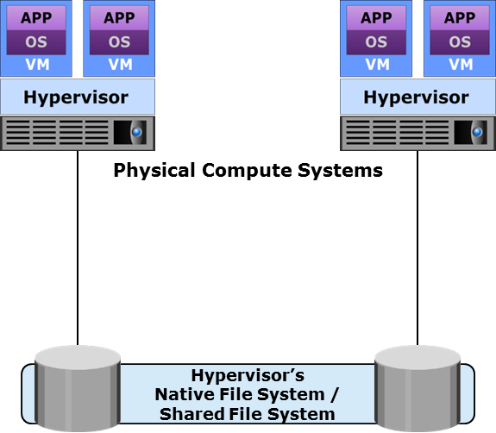
File System to Manage VM Files
Hypervisor’s native file system
Clustered file system deployed on local or external storage
Enables multiple hypervisors to perform concurrent reads and writes
Enables high availability to protect against hypervisor or compute system failure
Shared file system
Enables storing VM files on remote file servers or NAS devices
Hypervisors have built-in NFS or CIFS clients
Notes:
When a VM is created, the associated VM files are created and placed on the storage that is presented to the hypervisor. A file system is configured on the storage to manage the VM files. Most hypervisors support two types of file systems: the hypervisor’s native file system, and a shared file system, such as NFS or CIFS.
A hypervisor’s native file system is usually a clustered file system, and the storage presented to it is typically optimized to store the VM files. The file system can be deployed on the storage provisioned either from a local storage, or from external storage devices connected through Fibre Channel, iSCSI, or FCoE. The file system allows multiple hypervisors, running on different physical compute systems, to read from and write to the same shared storage resources concurrently. This enables high availability capabilities, such as the migration of VMs between clustered hypervisors in the event of failure of one of the hypervisors or compute systems. A locking mechanism ensures that a VM is not powered on by multiple hypervisors at the same time. When a hypervisor fails, the locking mechanism for each VM running on the physical compute system is released. It is then possible for the VMs to be restarted on other hypervisors.
A shared file system enables VM files to be stored on remote file servers or NAS devices that are accessed over an IP-based network. The file systems are accessed using file sharing protocols, such as NFS and CIFS. Hypervisors have built-in NFS or CIFS clients that enable communication with the file servers and NAS devices.
The capacity of the file system can be dynamically increased without disrupting the VMs running on a physical compute system. If the volumes on which the file system resides have additional configurable capacity, then the file system can be extended to increase its capacity. However, if there is no configurable capacity available on the volumes, then additional capacity must be assigned before the file system can be extended.

Slide 26
VM Console
VM console is an interface to view and manage the VMs on a compute system or a cluster
VM console may be:
Installed locally on a compute system
Web-based
Accessed over a remote desktop connection
Used to perform activities such as:
Installing a guest OS and accessing VM BIOS
Powering a VM on or off
Configuring virtual hardware and troubleshooting
Notes:
An administrator connects to a VM using its console, which is an interface to view and manage the VMs on a compute system or a cluster. The console may be installed locally on a compute system, web-based, or accessed over a remote desktop connection. An administrator uses the console to perform activities, such as installing a guest OS, accessing the BIOS of the VM, powering a VM on or off, editing startup and shutdown settings, configuring virtual hardware, removing VMs, troubleshooting, and so on.

Slide 27
VM Template
VM Template
A master copy of a VM with standardized virtual hardware and software configuration that is used to create new VMs
Created in two ways:
Converting a VM into a template
Cloning a VM to a template
Steps involved in updating a VM template are:
Convert the template into VM
Install new software or OS/software patches
Convert the VM back to a template
Notes:
A VM template is a master copy of a virtual machine with a standardized virtual hardware and software configuration that can be used to create and provision new VMs. The VM template typically includes a guest OS, a set of applications, and the hardware and software configurations required to deploy a VM. Templates can be created in two ways either by converting a VM to a template or by cloning a VM to a template. When a VM is converted to a template, the original VM is replaced by the template. When a VM is cloned to a template, the original VM is retained. A VM template provides preinstalled and preconfigured software, which makes the provisioning of VMs faster and eliminates installation, configuration, and maintenance overheads. It also enables ensuring consistency and standardization across VMs, which makes it easier to diagnose and troubleshoot problems.
A VM template can be updated with new software, and with OS and software patches. Updating the VM template involves the conversion of the template back to a VM and then the installation of the new software or patches on the VM. After the update is complete, the VM is converted back into a template. While updating the template, the relevant VM must be isolated to prevent user access.

Slide 28
Virtual Appliance
Virtual Appliance
Preconfigured virtual machine(s) preinstalled with a guest OS and an application dedicated to a specific function.
Used for functions, such as providing SaaS, routing packets, or deploying a firewall
Simplifies the delivery and operation of an application
Simplifies installation and eliminates configuration issues
The application is protected from issues in other virtual appliances
Typically created using Open Virtualization Format (OVF)
Notes:
A virtual appliance is a preconfigured virtual machine preinstalled with a guest operating system and an application dedicated to a specific function. In a cloud environment, virtual appliances are used for different functions, such as to provide Software as a Service, to run cloud management software, and to route packets. They can also be used to provide security features, such as a firewall or network intrusion detection.
Using a virtual appliance simplifies the delivery and operation of an application. Typically, the process is time-consuming and error-prone, and involves setting up a new VM, installing the guest OS and then the application. In contrast, a virtual appliance deployment is faster because the VM is preconfigured and has preinstalled software. This simplifies installation and eliminates configuration issues, such as software or driver compatibility problems. Also, the application runs in isolation within the virtual appliance, and it is protected against the crashes and the security issues of the other virtual appliances. Virtual appliances are typically created using the Open Virtualization Format (OVF) – an open hypervisor-independent packaging and distribution format.

Slide 29
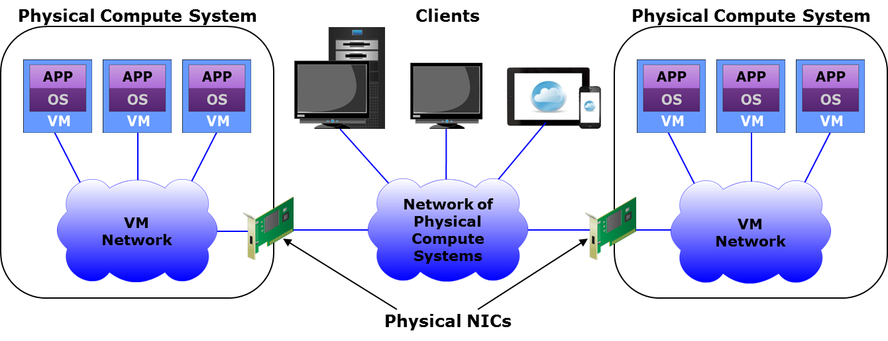
VM Network
VM Network
A logical network that provides Ethernet connectivity and enables communication between VMs within a compute system.
Notes:
A VM network is a logical network that provides Ethernet connectivity and enables communication between the VMs running on a hypervisor within a compute system. A VM network includes logical switches called virtual switches. Virtual switches function similar to physical Ethernet switches, but may not have all the functionalities of a physical Ethernet switch.
Consider the example of a web application that is running on a VM and needs to communicate with a database server. The database server could be running on another VM on the same compute system. The two VMs can be connected via a VM network to enable them to communicate with each other. Because the traffic between the VMs does not travel over a network external to the compute system, the data transfer speed between the VMs is increased.
In some cases, the VMs residing on different compute systems may need to communicate either with each other, or with other physical compute systems, such as a client machines. To transfer these types of network traffic, the VM network must be connected to the network of physical compute systems. In this case, the VM traffic travels over both the VM network and the network of physical compute systems. The figure on the slide shows two physical compute systems, each with a VM network and both the VM networks connected to a network of physical compute systems.

Slide 30
VM Network Components
Component | Description
Virtual switch | A logical OSI Layer 2 Ethernet switch created in a compute system Connects VMs locally and also directs VM traffic to a physical network Forwards frames to a virtual switch port based on destination address A distributed virtual switch can function across multiple physical compute systems
Virtual NIC | Connects a VM to a virtual switch and functions like a physical NIC Has unique MAC and IP addresses Forwards the VM’s network I/O in the form of Ethernet frames to the virtual switch
Uplink NIC | A physical NIC connected to the uplink port of a virtual switch Functions as an ISL between virtual and physical Ethernet switches Not addressable from the network
Notes:
VM networks comprise virtual switches, virtual NICs, and uplink NICs that are created on a physical compute system running a hypervisor.
A virtual switch is a logical OSI Layer 2 Ethernet switch created within a compute system. A virtual switch is either internal or external. An internal virtual switch connects only the VMs on a compute system. It has no connection to any physical NIC and cannot forward traffic to a physical network. An external virtual switch connects the VMs on a compute system to each other and also to one or more physical NICs. It enables the VMs to communicate internally and also to send traffic to external networks. A physical NIC already connected to a virtual switch cannot be attached to any other virtual switch. A virtual switch also provides traffic management for the VMs and maintains a MAC address table for forwarding frames to a virtual switch port based on the destination address. A single virtual switch, called distributed virtual switch, can also function across multiple physical compute systems. It is created and configured from a centralized management server. Once created, instances of the distributed virtual switch with identical networking configurations appear on each physical compute system managed by the management server. Configuration changes to the distributed virtual switch are applied to all its instances.
A virtual NIC connects a VM to a virtual switch and functions similar to a physical NIC. Virtual NICs send and receive VM traffic to and from the VM network. A VM can have one or more virtual NICs. Each virtual NIC has unique MAC and IP addresses and uses the Ethernet protocol exactly as a physical NIC does. The hypervisor generates the MAC addresses and allocates them to virtual NICs. The guest OS installed on a VM sends network I/O to the virtual NIC using a device driver similar to that of a physical NIC. A virtual NIC forwards the I/Os in the form of Ethernet frames to the virtual switch for transmission to the destination. It adds its MAC and IP addresses as source addresses to the Ethernet frames it forwards.
An uplink NIC is a physical NIC connected to the uplink port of a virtual switch and functions as an ISL between the virtual switch and a physical Ethernet switch. It is called uplink because it only provides a physical interface to connect a compute system to the network and is not addressable from the network. Uplink NICs are neither assigned an IP address nor are their built-in MAC addresses available to any compute system in the network. It simply forwards the VM traffic between the VM network and the external physical network without modification.

Slide 31
Lesson Summary
During this lesson the following topics were covered:
Virtual machine and VM hardware
VM files and file system to manage VM files
VM console
VM template
Virtual appliance
VM network and its components
Notes:
This lesson covered virtual machines and VM hardware. It also covered the files associated with a VM and the file system to store and manage the VM files. Next, it covered VM console, VM template, and virtual appliance. Finally, it covered VM network and its components.

Slide 32
Lesson: Virtual Resources – II
This lesson covers the following topics:
Logical unit number (LUN)
Creating LUN from RAID set
Creating LUN from storage pool
Notes:
This lesson covers Logical unit number (LUN) and the different ways to create LUNs.

Slide 33
Logical Unit Number (LUN)
Logical Unit Number (LUN)
Abstracts the identity and internal functions of storage system(s) and appear as physical storage to the compute system.
Mapping of virtual to physical storage is performed by the virtualization layer.
Provider provisions LUN to consumers for storing data
Storage capacity of a LUN can be dynamically expanded or reduced
LUN can be created from
RAID set (traditional approach)
Storage pool
Notes:
LUN (logical unit number) is created by abstracting the identity and internal function of storage system(s) and appears as physical storage to the compute system. The mapping of virtual to physical storage is performed by the virtualization layer. LUNs are assigned to the compute system to create a file system for storing and managing files. In a shared environment, there may be a chance that this LUN can be accessed by an unauthorized compute system. LUN masking is a process that provides data access control by defining which LUNs a compute system can access. This ensures that volume access by compute systems is controlled appropriately, preventing unauthorized or accidental access. In a cloud environment, the LUNs are created and assigned to different services based on the requirements. For example, if a consumer requires 500 GB of storage for their archival purpose, the service provider creates a 500 GB LUN and assigned it to the consumer. The storage capacity of a LUN can be dynamically expanded or reduced based on the requirements. A LUN can be created from a RAID set (traditional approach) or from a storage pool. The subsequent slides discuss these in detail.

Slide 34
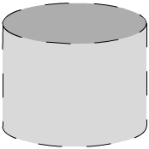
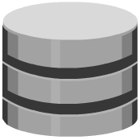
Creating LUNs from RAID Set
LUNs are created from a RAID set by partitioning the available capacity into smaller units
Spread across all the physical disks that belong to a RAID set
Suited for applications that require predictable performance
Compute
System 1
Virtual
Volume 0
Compute
System 2
Virtual
Volume 1
RAID Set
Notes:
In the traditional approach, a LUN is created from a RAID set by partitioning the available capacity into smaller units. A RAID set includes physical disks that are logically grouped together and the required RAID level is applied. LUNs are spread across all the physical disks that belong to a RAID set. The figure on the slide shows a RAID set consisting of four disks that has been partitioned into two LUNs: LUN 0 and LUN 1. Traditional LUNs are suited for applications that require predictable performance. Traditional LUNs provide full control for precise data placement and allow an administrator to create LUNs on different RAID groups, if there is any workload contention. Organizations that are not highly concerned about storage space efficiency may still use traditional LUNs.

Slide 35
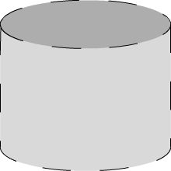

Creating LUNs from Storage Pool
Two types of volumes are created from storage pool:
Thin LUN
Does not require physical storage to be completely allocated at the time of creation
Consumes storage as needed from the underlying storage pool in increments called thin LUN extents
Thick LUN
Physical storage is completely allocated at the time of creation
Thin LUN
(10 TB)
Thick
LUN
Compute
Reported Capacity
4 TB
Allocated
4 TB
Allocated
Compute
Reported Capacity
Disk Drives
Storage Pool
Notes:
LUNs can be created from the storage pool that comprises a set of physical drives that provide the actual physical storage used by the volumes. A storage pool can contain a few drives or hundreds of drives. Two types of LUNs can be created from the storage pool: Thin LUNs and Thick LUNs.
Thin LUNs do not require physical storage to be completely allocated to them at the time they are created and presented to a compute system. From the operating system’s perspective, a thin LUN appears as a traditional LUN. Thin LUNs consume storage as needed from the underlying storage pool in increments called thin LUN extents. The thin LUN extent defines the minimum amount of physical storage that is consumed from a storage pool at a time by a thin LUN. When a thin LUN is destroyed, its allocated capacity is reclaimed to the pool.
Thick LUN is the one whose space is fully allocated upon creation. However, when a thick LUN is created its entire capacity is reserved and allocated in the pool for use by that LUN.

Slide 36
Use of Thin LUN
Thin LUNs are appropriate for applications that can tolerate performance variations
In some cases, performance improvement is seen when using a thin volume due to striping across large number of drives in the pool
Environments where cost, storage utilization, space, and energy efficiency is paramount
For applications where storage space consumption is difficult to forecast
Environment that needs optimized self provisioning
Notes:
A thick LUN created from a storage pool provides better performance than a thin LUN that is created from the same storage pool. However, a thin LUN offers several benefits. Thin LUNs are appropriate for applications that can tolerate performance variations. In some cases, performance improvement is seen when using a thin LUN, due to striping across a large number of drives in the pool. However, when multiple thin LUNs contend for the shared storage resources in a given pool, and when utilization reaches higher levels, the performance can degrade. Thin LUNs provide the best storage space efficiency and are particularly suitable for applications where space consumption is difficult to forecast. Using thin LUNs, cloud service providers can reduce storage costs and simplify their storage management.

Slide 37
Lesson Summary
During this lesson the following topics were covered:
LUN
Creating LUN from RAID set
Creating LUN from storage pool
Notes:
This lesson covered LUN and the different ways to create LUNs.

Slide 38
Lesson: Virtual Resources – III
This lesson covers the following topics:
Virtual network
Types of virtual networks: VLAN and VSAN
Mapping between VLANs and VSANs in an FCoE SAN
Notes:
This lesson covers virtual network and the types of virtual networks including VLAN and VSAN. It also covers the mapping between VLANs and VSANs in an FCoE SAN.

Slide 39
Virtual Network
Virtual Network
A software-based logical network that is either a segment of a physical network or spans across multiple physical networks.
Appears as a physical network to the connected nodes
Virtual networks share network components without leaking information between them
Network traffic is routed only when two nodes in different virtual networks are communicating
All types of networks can be virtualized, such as compute network, SAN, and VM network
Notes:
A Virtual network is a software-based logical network that is created from a unified pool of network resources. A virtual network can be created by segmenting a single physical network into multiple logical networks. For example, multiple virtual networks may be created on a common network infrastructure for the use of the different departments in an organization. Also, multiple physical networks can be consolidated into a single virtual network. A virtual network utilizes the underlying physical network only for simple packet forwarding. It appears as a physical network to the nodes connected to it, because existing network services are reproduced in the logical space. Nodes with a common set of requirements can be functionally grouped in a virtual network, regardless of the geographic location of the nodes.
Two nodes connected to a virtual network can communicate with each other without the routing of frames even if they are in different physical locations. Network traffic must be routed when two nodes in different virtual networks communicate even if they are connected to the same physical network. Virtual networks are isolated and are independent of each other. Each virtual network has unique attributes, such as routing, switching, independent polices, quality of service, bandwidth, security, and so on. The network management traffic and the broadcasts within a virtual network generally do not propagate to the nodes in another virtual network.
All types of network can be virtualized, including networks of physical compute systems, SANs, and VM networks. Virtual networks are programmatically created, provisioned, and managed from a network management workstation. Network and security services become part of individual VMs in accordance with networking and security policies defined for each connected application. When a VM is moved to a hypervisor on another compute system, its networking and security services also move with it. When new VMs are created to scale an application, the necessary policies are dynamically applied to those VMs as well.
Virtual networks enable a cloud provider to create logical networks that span physical boundaries, allowing network extension and optimizing resource utilization across clusters and cloud data centers. Virtual networks can also be scaled without reconfiguring the underlying physical hardware. Providers can also integrate network services, such as firewalls, and load balancers. A single console for all the services further simplifies management operations.

Slide 40
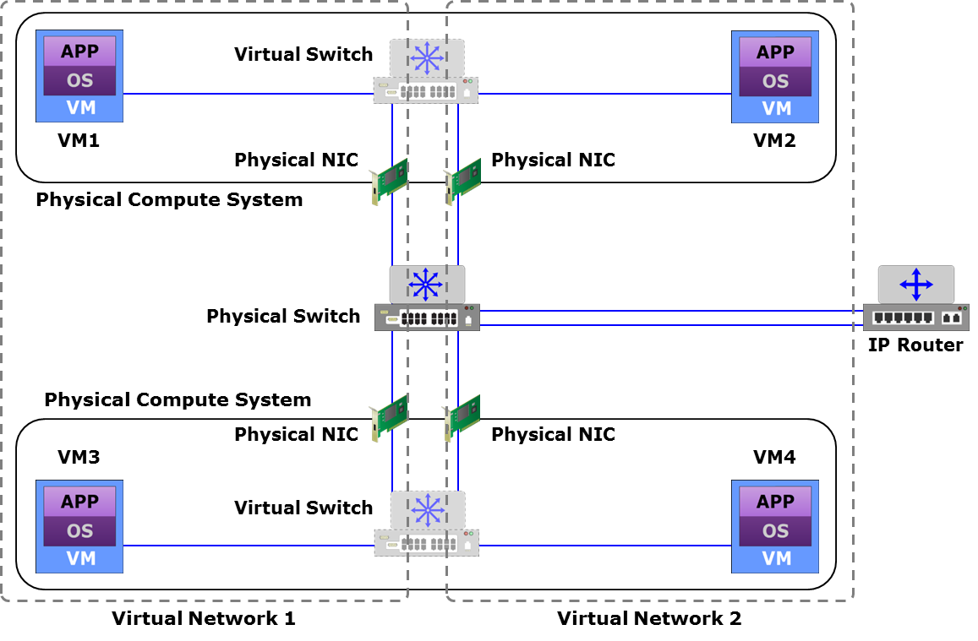
Virtual Network Example
Notes:
The figure on the slide shows two virtual networks that are created on both virtual and physical switches. Virtual network 1 connects VM1 and VM3 and enables communication between them without routing. Similarly, VM2 and VM4 are connected by virtual network 2. Communication between VM1 and VM2 or between VM3 and VM4 must be routed. The network traffic movement between virtual networks may be controlled by deploying access control at the router.

Slide 41
Common Types of Virtual Networks
Virtual LAN (VLAN)
Private VLAN (PVLAN)
Stretched VLAN
Virtual extensible LAN (VXLAN)
Virtual SAN (VSAN)
Notes:
The slide lists the common types of virtual networks.

Slide 42
Virtual LAN (VLAN)
Virtual LAN (VLAN)
A virtual network created on a LAN enabling communication between a group of nodes with a common set of functional requirements, independent of their physical location in the network.
A VLAN is identified by a unique 12-bit VLAN ID
Configuring a VLAN:
Define VLAN on physical and virtual switches and assign VLAN ID
Configure VLAN membership based on port, MAC address, protocol, IP subnet address, or application
Notes:
A virtual LAN (VLAN) is a virtual network consisting of virtual and/or physical switches, which divides a LAN into smaller logical segments. A VLAN groups the nodes with a common set of functional requirements, independent of the physical location of the nodes. In a multi-tenant cloud environment, the provider typically creates and assigns a separate VLAN to each consumer. This provides a private network and IP address space to a consumer, and ensures isolation from the network traffic of other consumers.
Traditionally in a physical network, a router is typically used to create a LAN and the LAN is further segmented by using switches and hubs. In a physical LAN, the nodes, switches, and routers are physically connected to each other and must be located in the same area. VLANs enable a network administrator to logically segment a LAN, and the nodes do not have to be physically located on the same LAN. For example, a cloud provider may place the VMs of a consumer in the same VLAN, and the VMs may be on the same compute system or different ones. Also, if a node is moved to another location, depending on the VLAN configuration, it may still stay on the same VLAN without requiring any reconfiguration. This simplifies network configuration and administration. A node (VM, physical compute system, or storage system) may be a member of multiple VLANs, provided the OS, hypervisor, and storage array OS support such configurations.
To configure VLANs, an administrator first defines the VLANs on the physical and virtual switches. Each VLAN is identified by a unique 12-bit VLAN ID (as per IEEE specification 802.1Q). The next step is to configure the VLAN membership based on different techniques, such as port-based, MAC-based, protocol-based, IP subnet address-based, or application-based. In the port-based technique, membership in a VLAN is defined by assigning a VLAN ID to a physical or virtual switch port or port group. In the MAC-based technique, the membership in a VLAN is defined on the basis of the MAC address of the node. In the protocol-based technique, different VLANs are assigned to different protocols based on the protocol type field found in the OSI Layer 2 header. In the IP subnet address-based technique, membership is based on the network IP subnet address of the OSI Layer 3 header. In the application-based technique, a specific application, for example, a file transfer protocol (FTP) application can be configured to execute on one VLAN. A detailed discussion on these VLAN configuration techniques is beyond the scope of this course.

Slide 43
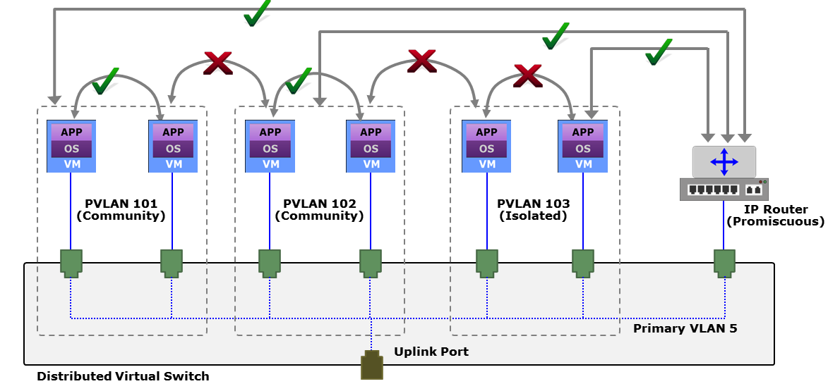
Private VLAN (PVLAN)
Private VLAN
A sub-VLAN that segregates the nodes within a standard VLAN, called as primary VLAN. A PVLAN can be configured as either isolated or community.
Enables a provider to support a larger number of consumers
Provides security between nodes on the same VLAN
Simplifies network management
Notes:
A private VLAN (PVLAN) is an extension of the VLAN standard and further segregates the nodes within a VLAN into sub-VLANs. A PVLAN is made up of a primary VLAN and one or more secondary (or private) VLANs. The primary VLAN is the original VLAN that is being segregated into smaller groups. Each secondary PVLAN exists only inside the primary VLAN. It has a unique VLAN ID and isolates the OSI Layer 2 traffic from the other PVLANs. Primary VLANs are promiscuous, which means that ports on the PVLANs can communicate with ports configured as the primary VLAN. Routers are typically attached to promiscuous ports.
There are two types of secondary PVLANs within a primary VLAN: Isolated and Community.
Isolated: A node attached to a port in an isolated secondary PVLAN can only communicate with the promiscuous PVLAN.
Community: A node attached to a port in a community secondary PVLAN can communicate with the other ports in the same community PVLAN as well as with the promiscuous PVLAN. Nodes in different community PVLANs cannot communicate with each other.
To configure PVLANs, the PVLAN feature must be supported and enabled on a physical switch or a distributed virtual switch. To create PVLANs, the administrator first creates standard VLANs on a switch, and then configures the VLANs as primary and secondary. The figure on the slide illustrates how different types of PVLANs enable and restrict communications between VMs (nodes) that are connected to a distributed virtual switch.
PVLANs enable a cloud provider to support a larger number of consumers and addresses the issues with scalability encountered in VLANs. If a service provider assigns one VLAN per customer, it limits the number of consumers that can be supported. Also, a block of addresses are assigned to each consumer VLAN, which can result in unused IP addresses. Additionally, if the number of nodes in the VLAN increases, the number of assigned addresses may not be large enough to accommodate them. In a PVLAN, all members share a common address space, which is allocated to the primary VLAN. When nodes are connected to secondary VLANs, they are assigned IP addresses from the block of addresses allocated to the primary VLAN. When new nodes are added in different secondary VLANs, they are assigned subsequent IP addresses from the pool of addresses.
(Cont'd)

Slide 44
Private VLAN (PVLAN)
Private VLAN
A sub-VLAN that segregates the nodes within a standard VLAN, called as primary VLAN. A PVLAN can be configured as either isolated or community.
Enables a provider to support a larger number of consumers
Provides security between nodes on the same VLAN
Simplifies network management
Notes:
PVLANs also provide an additional layer of security between the nodes that belong to the same VLAN. They also simplify the administrative overhead of maintaining access control lists (ACLs) on different VLANs, which restrict network traffic movement between VLANs. Further, a provider can ensure network traffic isolation by configuring isolated PVLANs. Without isolated PVLANs, segregating network traffic from different consumers requires creating a large number of discrete VLANs.

Slide 45
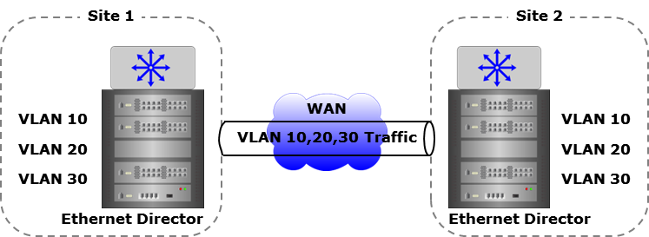
Stretched VLAN
Stretched VLAN
A VLAN that spans multiple sites and enables Layer 2 communication between a group of nodes over a Layer 3 WAN infrastructure, independent of their physical location.
Layer 2 WAN frames are encapsulated in Layer 3 WAN packets
Enables movement of VMs across locations without changing their network configuration
Notes:
A stretched VLAN is a VLAN that spans across multiple sites over a WAN connection. In a typical multi-site environment, two sites are connected over an OSI Layer 3 WAN connection and all network traffic between them is routed. Because of the routing, it is not possible to transmit OSI Layer 2 WAN traffic between the nodes in the two sites. A stretched VLAN extends a VLAN across the sites and enables nodes in the two different sites to communicate over a WAN as if they are connected to the same network.
Stretched VLANs also allow the movement of VMs between sites without having to change their network configurations. This enables the creation of high-availability clusters, VM migration, and application and workload mobility across sites. For example, in the event of a disaster or during the maintenance of one site, a provider typically moves VMs to an alternate site. Without a stretched VLAN, the IP addresses of the VMs must be changed to match the addressing scheme at the other site.
Stretched VLANs may be created by simply connecting two sites using long distance fiber and can be configured using different methods depending upon the underlying WAN technology. Stretched VLANs may be created by simply connecting two sites using long distance fiber, Dense Wave Division Multiplexing (DWDM), Coarse Wave Division Multiplexing (CWDM), multi-protocol label switching (MPLS) network, and IP network. An elaboration of these methods is beyond the scope of this course.

Slide 46
Virtual Extensible LAN (VXLAN)
Virtual Extensible LAN
A logical Layer 2 overlay network built on a Layer 3 network, which uses MAC-in-UDP encapsulation to enable communication between a group of nodes, independent of their physical location.
VXLAN header is added to a Layer 2 frame, which is placed in a UDP-IP packet and tunneled over a Layer 3 network
Enables transparent Layer 2 communication between nodes over physical networks spanning Layer 3 boundaries
Encapsulation and decapsulation are performed by Virtual Tunnel Endpoints (VTEPs)
24-bit VXLAN ID provides up to 16 million VXLANs
Notes:
A VXLAN is a OSI Layer 2 overlay network built on a OSI Layer 3 network. An overlay network is a virtual network that is built on top of existing network. VXLANs, unlike stretched VLANs, are based on LAN technology. VXLANs use the MAC Address-in-User Datagram Protocol (MAC-in-UDP) encapsulation technique. In this scheme, a VXLAN header is added to the original Layer 2 (MAC) frame, which is then placed in a UDP-IP packet and tunneled over a Layer 3 network. Communication is established between two tunnel end points called Virtual Tunnel Endpoints (VTEPs). At the transmitting node, a VTEP encapsulates the network traffic into a VXLAN header and at the destination node, a VTEP removes the encapsulation before presenting the original Layer 2 packet to the node. VXLANs enable the creation of a logical network of nodes across different networks. In case of VM communication, the VTEP is built into the hypervisor on the compute system hosting the VMs. VXLANs enable the separation of nodes, such as VMs, from physical networks. They allow the VMs to communicate with each other using the transparent overlay scheme over physical networks that could span Layer 3 boundaries. This provides a means to extend a Layer 2 network across sites. The VMs are unaware of the physical network constraints and only see the virtual Layer 2 adjacency.
Nodes are identified uniquely by the combination of their MAC addresses and a VXLAN ID. VXLANs use a 24-bit VXLAN ID, which makes it theoretically possible to have up to 16 million Layer 2 VXLANs co-existing on a common Layer 3 infrastructure. VXLANs make it easier for administrators to scale a cloud infrastructure while logically isolating the applications and resources of multiple consumers from each other. VXLANs also enable VM migration across sites and over long distances.

Slide 47
Virtual SAN (VSAN)
Virtual SAN
A logical fabric, created on a physical FC or FCoE SAN enabling communication between a group of nodes with a common set of requirements, independent of their physical location in the fabric.
A VSAN has its own fabric services, configuration, and set of FC addresses
Traffic disruptions in one VSAN do not affect other VSANs
A VSAN may be extended across sites similar to a stretched VLAN
Notes:
A virtual SAN (VSAN) or virtual fabric is a logical fabric created on a physical FC or FCoE SAN. A VSAN enables communication between a group of nodes with a common set of requirements, independent of their physical location in the fabric. A VSAN functions conceptually in the same way as a VLAN. Each VSAN behaves and is managed as an independent fabric. Each VSAN has its own fabric services, configuration, and set of FC addresses. Fabric-related configurations in one VSAN do not affect the traffic in another VSAN. Also, the events causing traffic disruptions in one VSAN are contained within that VSAN and are not propagated to the other VSANs. Similar to a stretched VLAN, a VSAN may be extended across sites by using long distance fiber, DWDM, CWDM, or FCIP links to carry the FC frames.

Slide 48
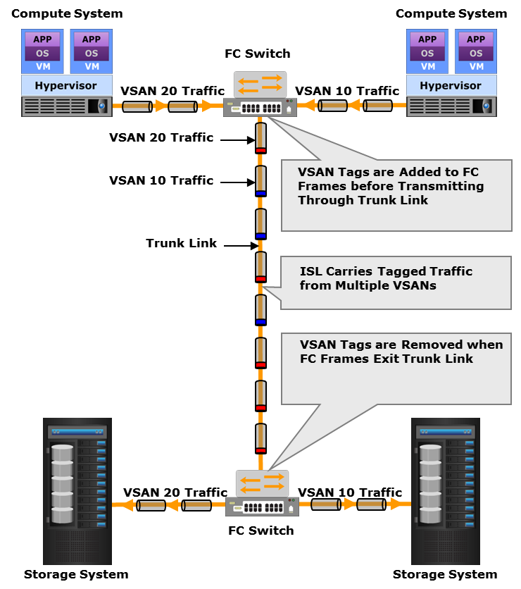
Virtual SAN (VSAN) (Cont'd)
Configuring VSAN:
Define VSANs on fabric switch with specific VSAN IDs
Assign VSAN IDs to F_Ports to include them in the VSANs
An N_Port connecting to an F_Port in a VSAN becomes a member of that VSAN
Notes:
To configure VSANs on a fabric switch, the VSANs are first defined with specific VSAN IDs. Then the F_Ports on the switch are assigned the VSAN IDs to include them in the respective VSANs. If an N_Port connects to an F_Port that belongs to a VSAN, it becomes a member of that VSAN.
Note: VSAN vs. Zone
Both VSANs and zones enable node ports within a fabric to be logically segmented into groups. But they are not same and their purposes are different. There is a hierarchical relationship between them. An administrator first assigns physical ports to VSANs and then configures independent zones for each VSAN. A VSAN has its own independent fabric services, but the fabric services are not available on a per-zone basis.

Slide 49
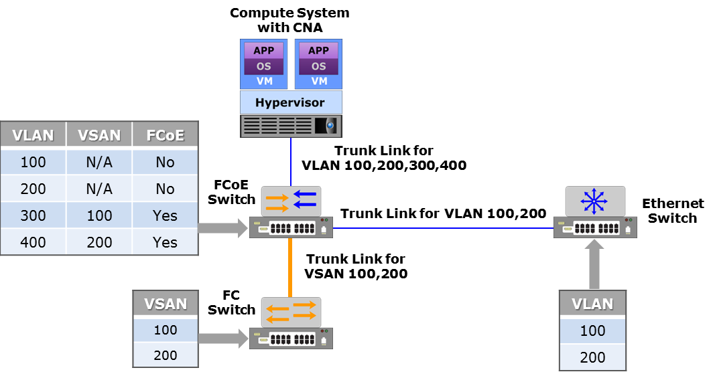
Mapping VLANs and VSANs in an FCoE SAN
Mapping determines which VLAN carries a VSAN traffic
Mapping considerations:
Configure a dedicated VLAN for each VSAN
VLANs configured for VSANs should not carry regular LAN traffic
Notes:
The FCoE protocol enables transmission of FC SAN traffic through a LAN that supports Data Center Bridging (DCB) functionalities. The FC frames remain encapsulated into Ethernet frames during transmission through the LAN. If VLANs and VSANs are created on the LAN and FC SAN respectively, a mapping is required between the VLANs and VSANs. The mapping determines which VLAN will carry FC traffic that belongs to a VSAN. The mapping of VSAN to VLAN is performed at the FCoE switch. Multiple VSANs are not allowed to share a VLAN. Hence, a dedicated VLAN must be configured at the FCoE switch for each VSAN. Also, it is recommended that VLANs that carry regular LAN traffic should not be used for VSAN traffic.
The figure on the slide shows an example of a mapping between VLANs and VSANs. In the example, the FCoE switch is configured with four VLANs: VLAN 100, VLAN 200, VLAN 300, and VLAN 400. The Ethernet switch is configured with two VLANs: VLAN 100 and VLAN 200. Both VLAN 100 and VLAN 200 transfer regular Ethernet traffic to enable compute-to-compute communication. The fabric switch has VSAN 100 and VSAN 200 configured. To allow data transfer between the compute system and the FC fabric through the FCoE switch, VSAN 100 and VSAN 200 must be mapped to VLANs configured on the FCoE switch. Since VLAN 100 and VLAN 200 are already being used for LAN traffic, VSAN 100 and VSAN 200 should be mapped to VLAN 300 and VLAN 400, respectively.

Slide 50
Lesson Summary
During this lesson the following topics were covered:
Virtual network
Types of virtual network: VLAN, private VLAN, stretched VLAN, VXLAN, and VSAN
Mapping between VLANs and VSANs in an FCoE SAN
Notes:
This lesson covered virtual network and the common types of virtual networks including VLAN, private VLAN, stretched VLAN, VXLAN, and VSAN. It also covered the mapping between VLANs and VSANs in an FCoE SAN.

Slide 51
Concepts in Practice
VMware ESXi
Notes:
The Concepts in Practice section covers VMware ESXi.
Note:
For the latest information on VMware products, visit www.vmware.com.

Slide 52
VMware ESXi
ESXi
Bare-metal hypervisor Abstracts processor, memory, storage, and network resources into multiple VMs Comprises underlying VMkernel OS that supports running multiple VMs VMkernel controls and manages compute resources
Notes:
VMware ESXi is a bare-metal hypervisor with a compact architecture that is designed for integration directly into virtualization-optimized compute system hardware, enabling rapid installation, configuration, and deployment. ESXi abstracts processor, memory, storage, and network resources into multiple VMs that run unmodified operating systems and applications. The ESXi architecture comprises underlying operating system called VMkernel, that provides a means to run management applications and VMs. VMkernel controls all hardware resources on the compute system and manages resources for the applications. It provides core OS functionality, such as process management, file system, resource scheduling, and device drivers.

Slide 53
Module Summary
Key points covered in this module:
Virtual layer
Virtualization software
Resource pool
Virtual resources
Notes:
This module covered the functions of virtual layer, virtualization software, resource pool, and virtual resources.

Slide 54
This slide intentionally left blank.

